Slide 1


CS 251
JUMPSTART
6
PROJECT
FILE COMPRESSION 2.0
Raka Primardika - Leeza Andryushchenko
RAKA PRIMARDIKA - LEEZA ANDRYUSHCHENKO

Slide 2
project jumpstart?
It is exactly what it sounds. It is a session to "jumpstart" you on the project. The TAs will prepare a presentation to guide you in starting the project. If you find reading long project descriptions overwhelming, this is for you!
They will first describe the project, answering any questions along the way. They will then help point you to course resources you may need to review to complete the project. They will lay out a project timeline, what to tackle first, etc. They will help you lay out different cases, edge cases, error handling, and more. They will help you brainstorm approaches, implementations, etc. They will give you time to map out your plan and ask questions.
Most importantly, the TAs will get you started. Sometimes the hardest part of doing any project is... getting started.
If you find yourself struggling to get started on projects for any reason (e.g. motivation, feeling overwhelmed by all the information, etc.), then Project Jumpstart is for you. If you would like to improve your project management skills, Project Jumpstart is for you. If you prefer listening and discussing rather than reading, Project Jumpstart is for you. If you need accountability, Project Jumpstart is for you. If you like the idea of being more efficient with your approach to solving problems, this might really help you.

Slide 3
JUMPSTART RECORDING LINK
https://uic.zoom.us/rec/share/r5VwyqLB6SJ9ixi4NALL0TROYCTrRY9hS4RKWQ8KSHumMnFv-Vx60aQVMw2ZbYG-.-VG1htHESQNrbOxg

Slide 4



EXAM WEEK
Oral exam
this project shouldn’t be that long, so focus on the exam first!

Slide 5
EXTRA CREDIT DEADLINE WEDNESDAY, NOVEMBER 10th
WE'RE BRINGING BACK
UNLIMITED SUBMISSIONS
NO TESTING REQUIRED
Notes:
Comeback of the century, Unlimited Submissions without testing requirements

Slide 6
FIRST OF TWO PROJECTS
REVISIT ADTs & DATA STRUCTURES
assemble all of them in a project
LINKED LISTS - ARRAYS - VECTORS - STACKS - QUEUES - PRIORITY QUEUES - TREES - HASH TABLES - MAPS - HASHMAPS - BINARY SEARCH TREES - GRAPHS
Notes:
We needed extra slides to reach 69 slides, forgive us for this

Slide 7
MULTIPLE DATA STRUCTURES
HASHMAP
hash table implementation along with an array of linked lists
PRIORITY QUEUE
a queue with a different insertion method
BINARY TREE
this is not a search tree
MYMAP
you should understand how to use mymap.h from Project 5
sanity check: If you do not have a working mymap.h file from Project 5, to compile your program, use the “compile” button. Otherwise, use “make build” in the terminal.
Notes:
You will use various data structures
Hash table
Array
Linked List
Priority Queue
Binary Tree
Maps
Note that the tree used is not a BST, just a regular tree with at most 2 children.

Slide 8

THIS PROJECT WILL TEST YOU ON
SYNTAX
there will be a lot of weird syntax stuff that you will encounter, so review the lectures and make sure you know how to understand C++ documentations
also try to understand the function parameters, some need pass-by-ref, some don’t
Notes:
Because of those multiple data structures involved here, the trickiest part in this project would be the actual coding bit.
How do I access this element? How to put?
Awkward syntax may be something like: this->array[hash(key)%num]->next->val
Or just declaring the priority queue, which will be quite baffling at first
So be prepared…
A useful skill would be to know how to read and understand C++ documentation as well as the starter code given to you

Slide 9
DOCUMENTATION LINKS
priority_queue - C++ Reference
istream::get - C++ Reference
ostream::put - C++ Reference
Project 4 Jumpstart - CS 251 Fall 2021
Project 5 Jumpstart - CS 251 Fall 2021
4. Optimize String Use: A Case Study - Optimized C++ [Book]
Notes:
Useful links you can look at while doing the project

Slide 10
AUTOGRADER TESTS
MILESTONE | TEST NAME | TEST CASES THAT SHOULD PASS | POINTS
0 | Hashmap | 1,2,3,4,5,6,7,8,9 | 23
1 | Option 1 | 1-9,10,17,24 | 35
2 | Option 2 | 1-10,17,24,11,18,25 | 47
3 | Option 3 | 1-9,10,11,17,18,24,25,12,19,26,42,43,44 | 74
4 | 4, Encode | 1-12,17-19,24-26,42-44,13,20,28,30,32,34,36,38,40 | 117
5 | 5, Decode | 1-13,17-20,24-26,28,30,32,34,36,38,40,42-44,14,21,29,31,33,35,37,39,41 | 160
6 | Valgrind | 1-14,17-21,24-26,28-44,Valgrind | 170
7 | Option C, B | 1-13,17-21,24-26,28-44,15,22,Valgrind | 178
8 | Option D, T | 1-15,17-22,24-26,28-44,16,23,27,Valgrind | 190
CC | Style | 1-44,Style,Valgrind | 195
Notes:
Useful links you can look at while doing the project

Slide 11
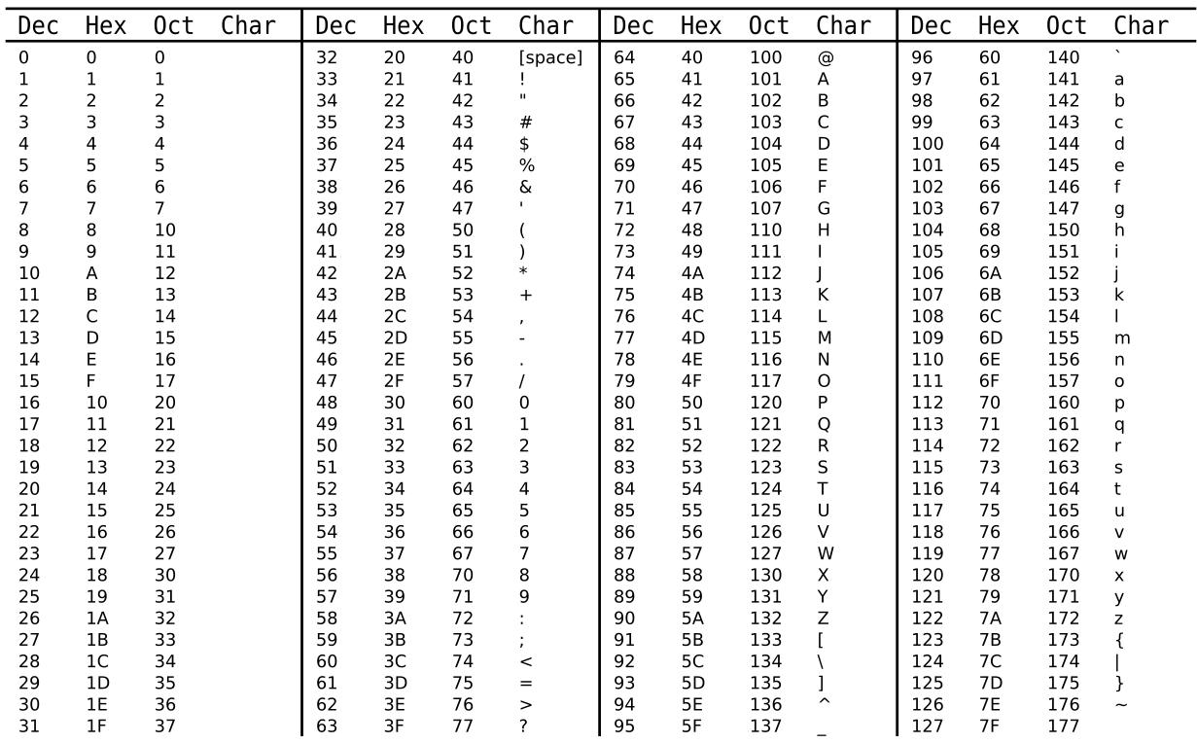
ASCII TABLE
IF YOU NEED IT
Notes:
ASCII table.
Useful ones:
‘0’ = 48
‘A’ = 65
‘a’ = 97

Slide 12
MILESTONE
0
HASHMAP

Slide 13
MILESTONE
0
IMPLEMENT A CLASS
HASHMAP
put
get
containsKey
keys
note: if you want to make your own tests.cpp file (recommended) to test your hashmap, remember that you would need to compile hashmap.cpp as well in order for it to work
Notes:
Acts like a regular map, but the time complexity should be near, but not O(1)

Slide 14

MILESTONE
0
DATA STRUCTURE
bucketArray buckets
array of linked lists, deals with collisions by chaining
0
key_val_pair*
key_val_pair
key_val_pair
key_val_pair
key_val_pair
key
4
key
7
key
0
key
5
val
#
val
#
val
#
val
#
next
next
next
next
1
key_val_pair*
key_val_pair
key_val_pair
key_val_pair
key_val_pair
key
11
key
65
key
3
key
21
val
#
val
#
val
#
val
#
next
next
next
next
2
key_val_pair*
key_val_pair
key_val_pair
key_val_pair
key_val_pair
key
44
key
45
key
41
key
12
val
#
val
#
val
#
val
#
next
next
next
next
3
key_val_pair*
key_val_pair
key_val_pair
key_val_pair
key_val_pair
key
2
key
33
key
55
key
90
val
#
val
#
val
#
val
#
next
next
next
next
Notes:
Just remember Project 4 syntax
Difference being the name of the nodes (key_val_pair) and the array name (buckets)
Note that bucketArray is defined as a shorthand/typedef for key_val_pair**

Slide 15

MILESTONE
0
HASH FUNCTION
KEY LOOKUP
GIVEN TO YOU
int hashFunction(int input)
MAGIC NUMBER
% number of buckets
BUCKET INDEX
Notes:
Remember to mod for the actual index of your hash table

Slide 16
MILESTONE
0
HOW IT WORKS
bucketArray buckets
0
23
134
1
put(44,307);
44
10923874
2
key_val_pair
% 10
3
32
0
45
677
hashFunction
(magic number)
key
44
val
307
nBuckets = 10;
4
89
13
44
307
next
nullptr
5
22
24
% 10
6
get(77);
37895638
7
33
8
99
806
77
144
9
6
574

Slide 17

MILESTONE
0
ASSIGNMENT
LinkedList.h
review: insert to the back of linked list, linear search through linked list (Week 7)
put | Put a new key/value pair into the hashtable.If the key already exists, update the value; otherwise, insert at the end of the linked list.
get | Returns the value associated with key. If the key is not in the hashtable, throw an error.
containsKey | Return true if the key is in the hashtable; otherwise return false.
keys | Return a vector of all the keys. The order should start from bucket 0, and go to bucket 9, each bucket’s key/value pairs should be added through normal front to back traversal of the linked list.
Notes:
put, get and containsKey should follow the diagram in the previous slide (how it works) and use the hash function provided
keys should be a normal array of linked list traversal, top to bottom, front to back

Slide 18
HUFFMAN ENCODING

Slide 19

WHY HUFFMAN?
EXAMPLE LARGE TEXT FILE
...
Smiling in his mischievous manner, he raises his head. The smile dies down. He looks deep into the eyes of Fury, Barton and Selvig. He stands up, holing the scepter.
NICK FURY
Sir, please put down the spear!
...
The Avengers entire script
135292 bytes
more frequent characters take up less memory
char | freq | Huffman Encoding
(space) | 21510 | 110
e | 8870 | 1000
t | 6975 | 0101
... | ... | ...
] | 1 | 10100111001111010
[ | 1 | 10100111001111001
EOF | 1 | 10100111001111011
compressed text file, 87313 bytes
{46:2615, 110:5459, 121:1558, 56:13, 108:3156, 102:1350, 75:613, 74:100, 115:5158, 58:10, 109:1650, 66:604, 95:5, 118:759, 77:597, 84:2736, 87:567, 113:36, 90:10, -125:1, 98:956, 48:33, 68:752, 119:1565, 101:8870, 99:1634, 50:40, 49:42, 76:1545, 83:1833, 122:41, 35:18, 34:8, 59:15, 91:1, 117:2556, 100:2558, 55:20, 54:30, 37:8, 10:2762, 47:14, 97:5731, 52:15, 106:104, 73:2767, 71:660, 70:501, 67:1168, 44:1226, 86:280, 81:29, 96:7, -74:8, 111:6482, 65:2567, 45:489, 85:820, 82:1901, 72:1449, -128:183, 112:1416, 51:20, 38:6, 80:598, 88:119, 40:36, 41:36, 89:793, 33:172, 104:4577, 116:6975, 105:4977, 53:19, 57:9, 63:342, 69:2357, -117:183, 39:700, 120:55, -106:10, 114:4354, 61:6, 103:1928, 107:1224, 78:2238, 32:21510, 79:1744, -30:183, -61:19, 93:1, 256:1}I�rD��]@��k�Vv�׆?E�������B�8{ȝr!w�u��rS�ɝr���8kgqgr�Y;k�+2�����"�M9����Rn�"w����@9�(眽\8{[.
...
Notes:
Example: dont explain a lot
Using Huffman Encoding to compress a very large text file would likely end up in a VERY SMALL text file. This is the main advantage of Huffman Encoding.

Slide 20
WHY HUFFMAN?
EXAMPLE SMALL TEXT FILE
He can see the celebrations starting,
He's got one more corner the famous Parabolica to go,
Mercedes threw everything at him
Charles Leclerc has coped brilliantly,
He won in SPA HE WINS IN MONZA!
Charles Leclerc is the winner of the 2019 Italian Grand Prix!
TV commentary
258 bytes
char | freq | Huffman Encoding
(space) | 39 | 110
e | 28 | 010
r | 17 | 1010
... | ... | ...
Z | 1 | 10010100
p | 1 | 10011010
G | 1 | 10011001
more frequent characters take up less memory
compressed text file, 460 bytes
{110:13, 108:10, 102:2, 121:2, 115:10, 109:3, 77:2, 118:1, 87:1, 90:1, 98:3, 119:3, 48:1, 101:28, 99:10, 76:2, 83:2, 50:1, 49:1, 10:6, 117:1, 100:3, 97:15, 44:3, 67:2, 73:3, 71:1, 72:4, 111:12, 65:2, 80:3, 112:1, 33:2, 116:14, 104:10, 105:12, 39:1, 69:1, 57:1, 120:1, 32:39, 114:17, 103:4, 78:3, 79:1, 256:1}�v�֥�Վ��r����y٧����g{�A���T��qz}��ï�㳷�a �:B�g��LI���O��v?b׫�/��Tg����:�~k��Z��<ڧE����%�lt8�p>�O���j��4��ﳫ!�H�ǝ]--5=w�y�N�,'tL���
Notes:
Counterexample: dont explain that much either
Using Huffman Encoding to compress a smaller text file would likely end up in a LARGER text file. This is a downside of Huffman Encoding.

Slide 21
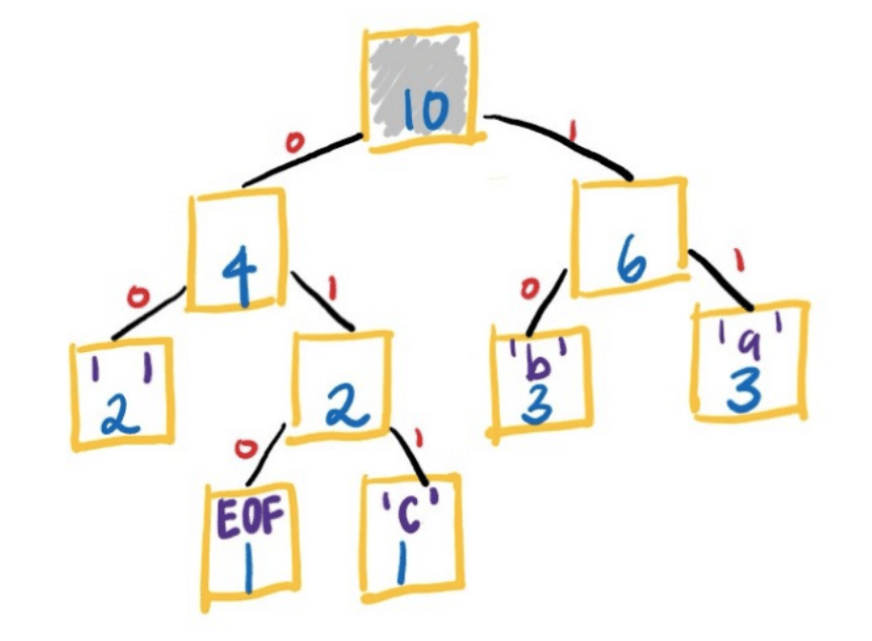
ab ab cab
1. count number of occurrences per character
2. Convert to priority queue
3. Build encoding tree
a | 3
b | 3
c | 1
(space) | 2
EOF | 1
EOF | 1
c | 1
(space) | 2
a | 3
b | 3
4. Build encoding map
a | 11
b | 10
c | 011
(space) | 00
EOF | 010
5. Encode
ab ab cab
1110001110000111110010
Notes:
The whole compression in a nutshell - map->priorityqueue->tree->another map
In the end, the input string “ab ab cab” should be a binary string

Slide 22
HUFFMAN ENCODING
1
5
MILESTONE
MILESTONE
MILESTONE
2
MILESTONE
6
MILESTONE
3
MILESTONE
7
MILESTONE
4
MILESTONE
8
util.h
Notes:
The whole encoding part will be created in util.h file (1-8 milestones)

Slide 23
1
MILESTONE
FREQUENCY MAP

Slide 24
1
MILESTONE
HASHMAP
KEYS ARE CHARACTERS, VALUES ARE FREQUENCIES
ab ab cab
KEY | VALUE
a | 3
b | 3
c | 1
(space) | 2
EOF | 1
keep in mind, both keys and values will be ints
use ASCII
Notes:
Create hashmap that maps char to its freq (number of times it appears on the file) and put them in the hashmap
Use the hashmap class you implemented earlier in MS0

Slide 25
1
MILESTONE
READING CHARS
2 SITUATIONS
ab ab cab
FILE
STRING
ifstream inFS(filename);
char c;
while (inFS.get(c)) {...}
for (char c : str) {...}
if isFile is true, filename is an actual filename
otherwise, treat filename as a string variable
Notes:
One of the string parameters is called filename. Another bool parameter is called isFile.
If isFile is true, filename is an actual file name. You open the file and read each char from the input file stream (left case)
If it’s false, you are to treat filename as a string variable. In other words, filename is the string itself, str. (right case)

Slide 26
1
MILESTONE
SPECIAL CHARS
PSEUDO_EOF = 256
AT END OF STRING, ADD THIS TO MAP
NOT_A_CHAR = 257
USE IN MILESTONE 2
Notes:
2 special characters here
After adding all characters from the string (last slide), you need to manually add PSEUDO_EOF with frequency 1 to your map
This character just means “End Of File”

Slide 27
MILESTONE
2
ENCODING TREE

Slide 28

MILESTONE
2
HUFFMAN NODE
TREES
HuffmanNode
int character;
int count;
HuffmanNode* zero;
HuffmanNode* one;
notice that this is a binary tree node
Think of zero as left
Think of one as right
Notes:
Character is an INT, yes. Please review ASCII tables
For example, if you found the character ‘C’ has frequency 12, you would have a HuffmanNode with character = 67, count = 12

Slide 29
MILESTONE
2
PRIORITY QUEUE
CONCEPT
stroke
small fever
1
6
front of queue
1 | 2 | 3 | 3 | 4 | 5 | 6 | 6
Mark | Theo | Karen | John | Tim | Max | Jess | Freya
3
Zara
you can only grab the front of the queue (Mark)
Notes:
Hospital Example
Front of the queue is the next one who gets treatment from the doctors.
The more severe the injury, the smaller the number, they get put closer to the front of the queue

Slide 30
MILESTONE
2
PRIORITY QUEUE
C++
priority_queue - C++ Reference
YOU ARE MAKING A P.Q. OF POINTERS
priority_queue<HuffmanNode*> pq;
if you copy-pasted this to your code, submitted it to the autograder and wonder why it doesn’t work, answer is in the next slide
don’t declare it like this!
// see next slide
Default Constructor, empty queue
front of queue
pq.push(newNode);
Push a node pointer into the queue
1 | 1 | 2 | 3 | 3
EOF | c | (space) | b | a
while (pq.size() > 1) {...}
Return the number of elements
HuffmanNode* first = pq.top();
Get the front of the queue
pq.pop();
Remove the front element
see week 11 lectures to manage the ordering
Check if the queue is empty
while (!pq.empty()) {...}
Notes:
Use the default C++ priority queue, don’t forget to #include <queue>

Slide 31
2
THERE’S GOING TO BE A LECTURE ON THIS TOPIC
MILESTONE
PRIORITY QUEUE
PAIR<INT,INT> EXAMPLE
priority_queue - C++ Reference
priority_queue<
pair<int,int>, // (key,value) pair
vector<pair<int,int>>, // store pairs in a vector
prioritize> pq; // function object
C++ is stupid, so you must explicitly tell the priority queue how you want to handle the ordering
class prioritize // you could also use a struct
{
public:
bool operator()(const pair<int,int>& p1, const pair<int,int>& p2) const
{
return p1.second > p2.second; // HuffmanNode* will be different
}
};
this is assuming the values are being compared (.second)
use p1 > p2 if you want smaller values at the front of the queue
your project will have HuffmanNode* instead of pair<int,int>
Notes:
When changing to HuffmanNode*, get rid of the ampersand(&) in the parameters because the node pointer is already a reference/memory address.

Slide 32
MILESTONE
2
PRIORITY QUEUE
FILLING IT UP
priority_queue - C++ Reference
Frequency Map
HuffmanNode
for every key-value pair in your frequency map, create a new node for it, then insert the node to the priority queue
3
a
KEY | VALUE
a | 3
b | 3
c | 1
(space) | 2
EOF | 1
new node
beware, syntax is tricky here
enqueue
front of queue
1 | 1 | 2 | 3 | 3
EOF | c | (space) | b | a
Notes:
Converting each key-value pair to a HuffmanNode* will require the “new” keyword, it should be somewhere in your code
Frequency is count
Key is character

Slide 33
MILESTONE
2
N_A_C:
NOT_A_CHAR = 257
ENCODING TREE
CONVERSION
front of queue
1 | 1 | 2 | 3 | 3
EOF | c | (space) | b | a
1. grab 2 nodes from the queue
4. enqueue the new node back to the priority queue
3. link them up to become a binary tree
1
EOF
1
c
2 | 2 | 3 | 3
(space) | N_A_C | b | a
2
N_A_C
2. create a new node where frequency is the sum
zero
one
2
N_A_C
1
EOF
1
c
zero
one
5. repeat until pq has 1 element left
Notes:
For step 1 & 2, follow this pseudocode:
Get top node, call it first pop
Pop
Get top node, call it second pop
Pop
Make new node, zero child is first pop, one child is second pop (always)
Enqueue new node
Once the queue only has one element left, that’s your root!

Slide 34
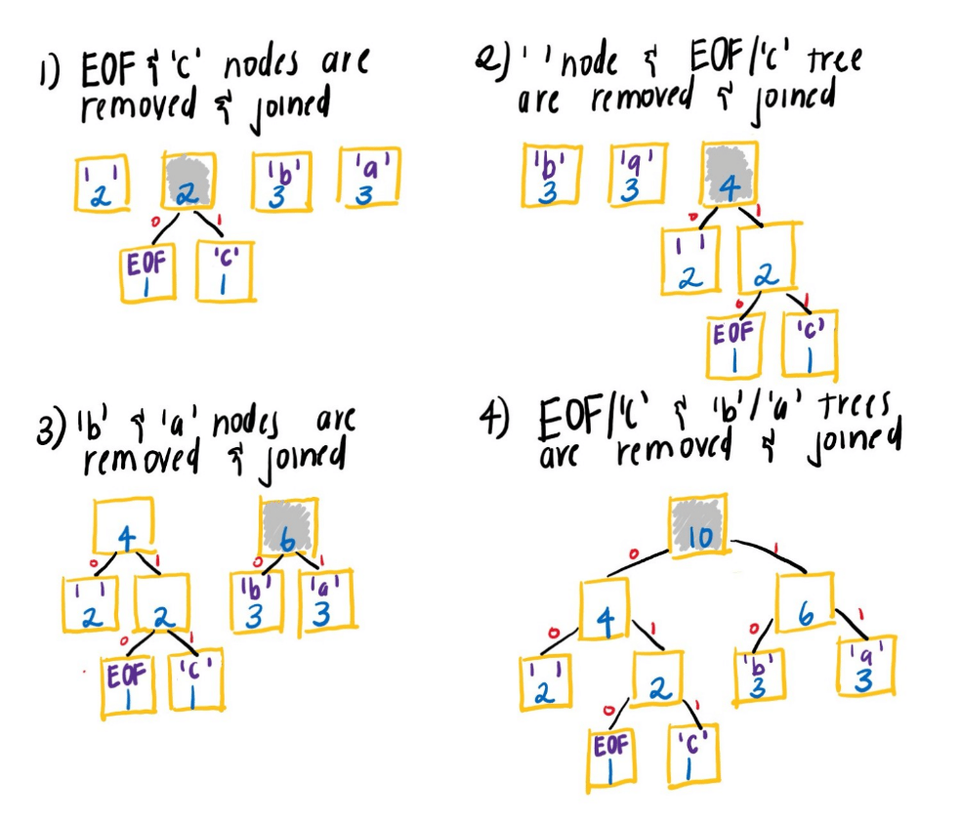
MILESTONE
2
ENCODING TREE
VISUALISED FURTHER
you end up with a binary tree

Slide 35
MILESTONE
2
ENCODING TREE
FINAL TREE
10
N_A_C
zero
one
4
N_A_C
6
N_A_C
zero
one
zero
one
2
N_A_C
2
(space)
3
b
3
a
zero
one
1
EOF
1
c
Notes:
Observation: All the characters are leaves of the tree. Think about how that makes the next milestone a bit easier...

Slide 36
MILESTONE
3
ENCODING (MY)MAP

Slide 37

3
YOU DON’T NEED TO HAVE STARTED/FINISHED PROJECT 5 AT ALL!
MILESTONE
REVISIT
PROJECT 5
Project 5 Jumpstart - CS 251 Fall 2021
ROOT
50
33
89
7
41
66
91
JUST REMEMBER THE MEMBER FUNCTIONS
YOU'LL NEED TO USE THEM

Slide 38
MILESTONE
3
MYMAP
SAMPLE USE
mymap<int,string> myMap;
Default Constructor, empty map
myMap.put((int)‘a’,”10010011”);
Put an int-string pair into the map
int x = myMap.Size();
Return the number of int-string pairs
string s = myMap.get((int)’a’);
Get a string value from an int key
if (myMap.contains(66)) {...}
Check if a key is in the map
for (int key : myMap) {...}
Loop through all the keys in the map

Slide 39
MILESTONE
3
ENCODING MAP
MYMAP<INT,STRING>
10
N_A_C
zero
one
Encoding Map
int | string
(space) | “00”
a | “11”
b | “10”
c | “011”
EOF | “010”
4
N_A_C
6
N_A_C
zero
one
zero
one
2
N_A_C
2
(space)
3
b
3
a
zero
one
1
EOF
1
c

Slide 40
MILESTONE
3
APPROACH
PATH 4
10
N_A_C
GO THROUGH ALL PATHS
PATH 1
zero
TO ALL LEAVES OF THE TREE
one
REMEMBER THE PATH
4
N_A_C
6
N_A_C
PATH 3
zero
one
zero
one
1. zero, zero : space
2. zero, one, zero : EOF
3. zero, one, one : c
4. one, zero : b
5. one, one : a
2
N_A_C
2
(space)
3
b
3
a
zero
one
1
EOF
1
c
PATH 5
PATH 2

Slide 41
MILESTONE
3
TRAVERSALS
THINK ABOUT IT
When traversing a single path, use LOOPS
When traversing the whole tree, use RECURSION
LOOPS
You must traverse every possible path,
i.e 0,1,00,01,10,11,000,001,010,011,100,101,110,111,etc.
If this was possible, would it be efficient?
RECURSION
You must figure out how to keep track of which path you are currently on
We think it’s the easier option!

Slide 42
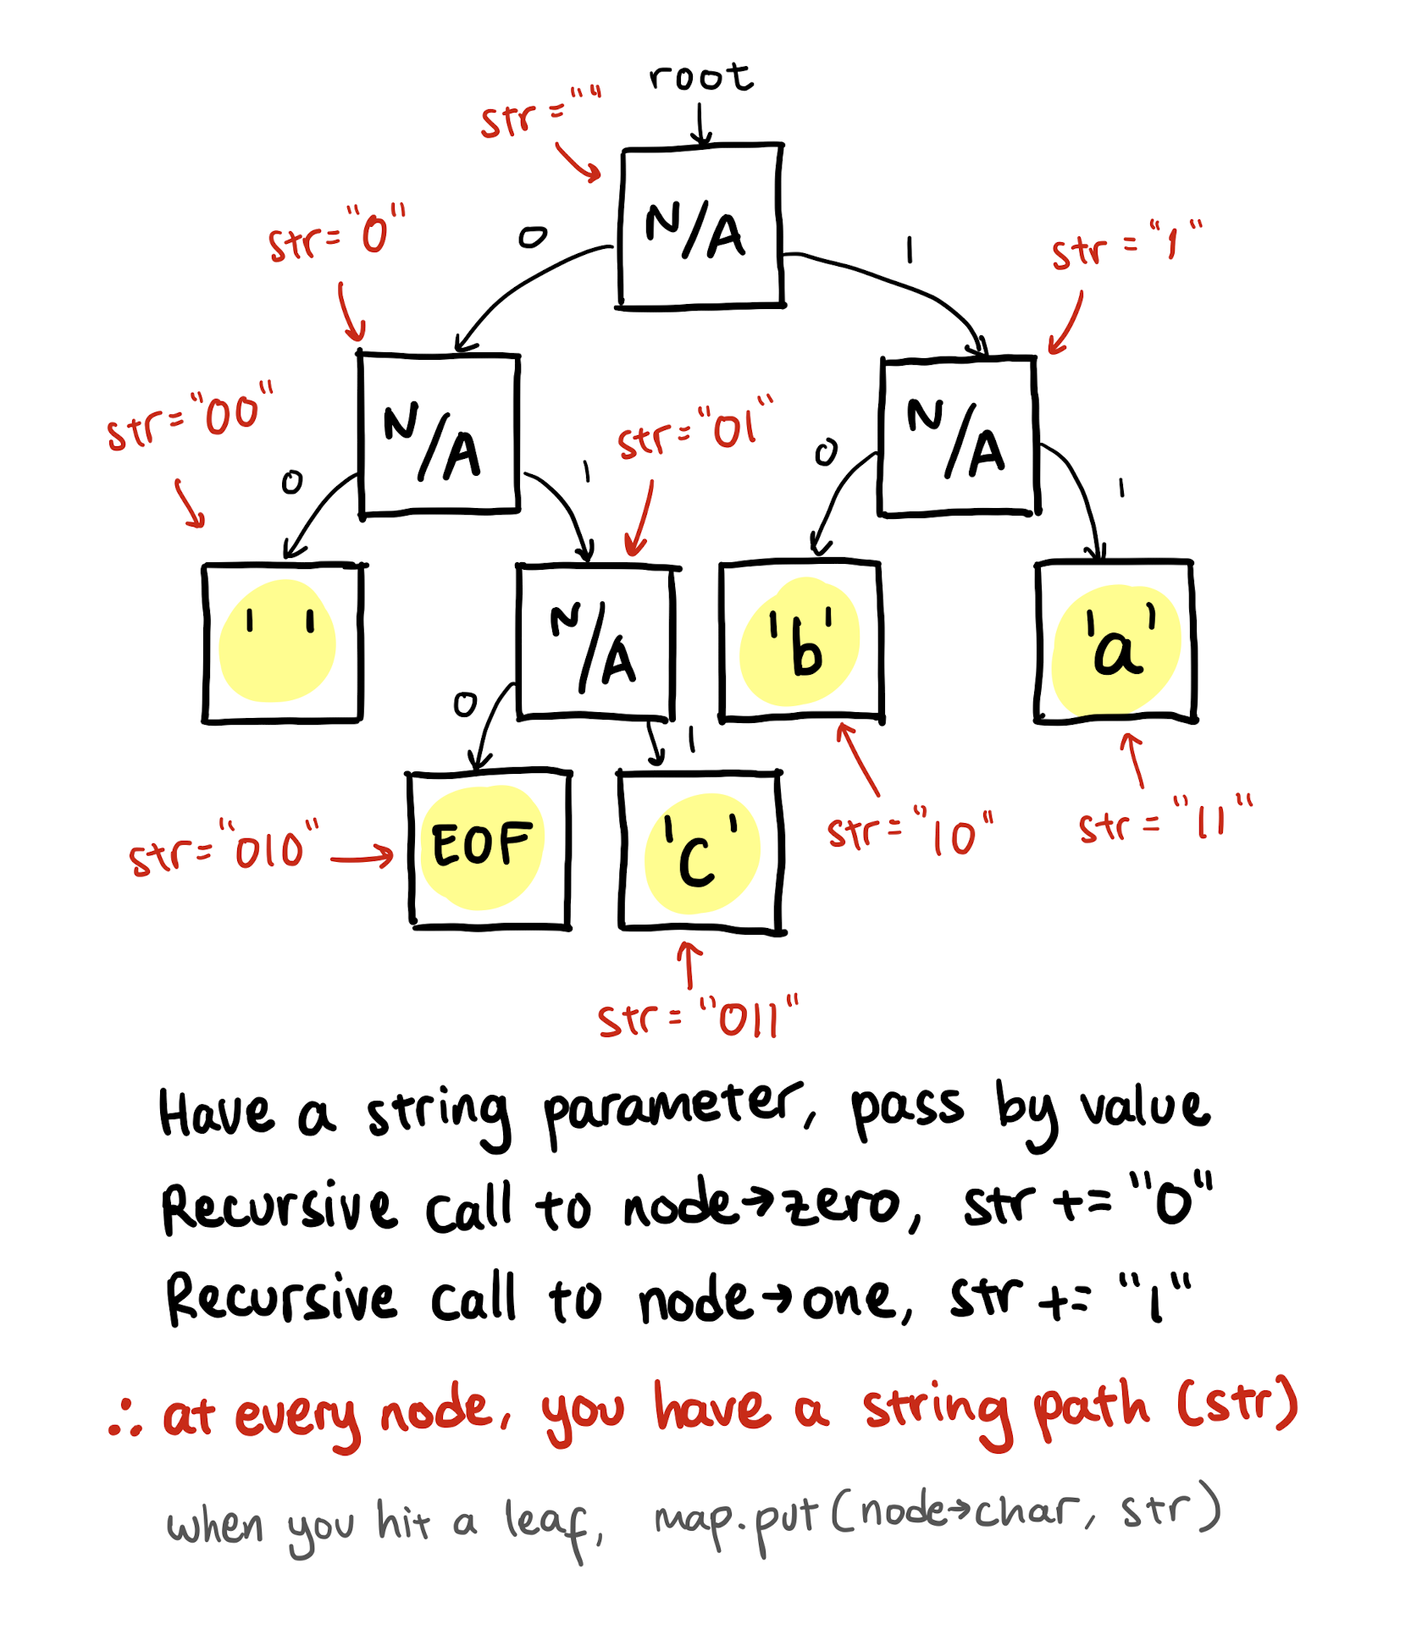
MILESTONE
3
RECURSION
APPROACH
condition for a leaf node
if (node->character != NOT_A_CHAR)
LEAF NODE!
Encoding Map
int | string
(space) | “00”
a | “11”
b | “10”
c | “011”
EOF | “010”

Slide 43
MILESTONE
4
ENCODE TEXT

Slide 44
4
YOU ALSO NEED TO MANUALLY ADD THE ENCODING FOR PSEUDO_EOF AFTER LOOPING THROUGH THE INPUT STRING
MILESTONE
BINARY STRING
ONLY HAS 1's & 0's
Encoding Map
int | string
(space) | “00”
a | “11”
b | “10”
c | “011”
EOF | “010”
Input String
ab ab cab
1110001110000111110010
Final String
"1110001110000111110010"

Slide 45
MILESTONE
4
WRITE TO FILE
if (makeFile == true)
Final String
"1110001110000111110010"
FOR EACH CHARACTER IN THIS STRING,
WRITE THE BIT TO THE OSTREAM
output.writeBit(0);
output.writeBit(1);
in the string, the 1’s and 0’s are chars but the arguments for the writeBit() functions are ints, therefore you need to handle that case as well
ASCII conversions: ‘0’ is 48, ‘1’ is 49

Slide 46
MILESTONE
4
SIGPIPE ERROR
HANDLING
this is caused by inefficient code
remove unnecessary loops and recursive calls
use the makeFile flag properly
str += add;
for concatenation

Slide 47
MILESTONE
5
DECODE TEXT

Slide 48
MILESTONE
5
READ FROM FILE
Input Stream
1110001110000111110010
FOR EACH BIT IN THE FILE STREAM,
TRAVERSE THE TREE
while (!input.eof()) {
int bit = input.readBit();
// TODO: something here
}

Slide 49
MILESTONE
5
TRAVERSE TREE
int bit = input.readBit();
10
N_A_C
zero
one
1110001110000111110010
4
N_A_C
6
N_A_C
if bit is 1, go right
if bit is 0, go left
if you reach a leaf,
add char to output string
then reset to the root
go on until you find EOF
zero
one
zero
one
2
N_A_C
2
(space)
3
b
3
a
zero
one
1
EOF
1
c
Output String
make sure you don’t actually output PSEUDO_EOF because that would cause ‘\u2400’ to be printed out as well, so the EOF is just a marker to break out of the loop
"ab ab cab"

Slide 50
MILESTONE
5
OUTPUT
Output String
"ab ab cab"
PUT ALL CHARACTERS
FROM THE STRING RESULT
TO THE OUTPUT STREAM
output.put(‘a’);
this function puts a character (1 byte) to the output stream

Slide 51
MILESTONE
6
FREE THE TREE

Slide 52
MILESTONE
6
"DESTRUCTOR"
Milestone 2 Encoding Tree
DELETING A BINARY TREE
REVIEW PROJECT 5 MILESTONE 4
POST-ORDER RECURSION

Slide 53
MILESTONE
7
COMPRESS

Slide 54
MILESTONE
7
COMPRESS
ONLY GIVEN A FILENAME
belgian_waffle.txt
create these, in this order
FREQUENCY MAP
ENCODING TREE
ENCODING MAP
Syntax will be tricky, pay careful attention to the function parameters. What types do they accept?

Slide 55
MILESTONE
7
OUTPUT FILE
ONLY GIVEN A FILENAME
belgian_waffle.txt
prepare an output bit stream to a new .huf file you will create
ofbitstream output(“belgian_waffle.txt.huf”);
output your frequency map from before to the ofbitstream
output << frequencyMap;
this syntax should suffice... clean, right?

Slide 56
7
DON’T FORGET TO CALL freeTree() TO PASS VALGRIND TESTS
MILESTONE
ENCODE
prepare an input stream from the original filename
ifstream input(“belgian_waffle.txt”);
at this point, you should have:
input stream, output bit stream, frequency map, encoding tree, encoding map
CALL ENCODE FUNCTION
RETURN RESULTING STRING
Syntax will be tricky, pay careful attention to the function parameters.

Slide 57
MILESTONE
8
DECOMPRESS

Slide 58
MILESTONE
8
INPUT & OUTPUT
ONLY GIVEN A FILENAME
belgian_waffle.txt.huf
prepare an input bit stream from the .huf file given
ifbitstream input(“belgian_waffle.txt.huf”);
prepare an output stream to a new file you will make
ofstream output(“belgian_waffle_unc.txt”);
string parsing the filename would be suggested

Slide 59
MILESTONE
8
DECOMPRESS
ONLY GIVEN A FILENAME
belgian_waffle.txt.huf
create these, in this order
FREQUENCY MAP
ENCODING TREE
build your frequency map from the ifbitstream
input >> frequencyMap;
here’s the clean syntax again

Slide 60
8
DON’T FORGET TO CALL freeTree() TO PASS VALGRIND TESTS
MILESTONE
DECODE
belgian_waffle.txt.huf
at this point, you should have:
input bit stream, output stream, frequency map, encoding tree
CALL DECODE FUNCTION
RETURN RESULTING STRING
Syntax will be tricky, pay careful attention to the function parameters.

Slide 61
BIG HINT
MILESTONE
7
MILESTONE
8
main.cpp
If you look at the main program, you can find code for:
FILENAME PARSING
WHAT TO DO
Just try to understand how main manages the input and output streams, what are the parameters passed in to the functions, the steps of what to do. Copy-pasting from main won’t work!

Slide 62
MILESTONE
9
CREATIVE COMPONENT

Slide 63
MILESTONE
9
SUBMIT
secretmessage.txt.huf
{110:17, 121:8, 108:4, 118:7, 115:2, 109:1, 119:1, 98:1, 101:20, 99:1, 117:9, 10:5, 100:6, 97:12, 111:15, 112:1, 105:2, 116:4, 104:1, 78:6, 114:11, 32:28, 103:8, 107:1, 256:1}��98�����4��spd
����9G�R��S�ۚ'�?���98�&���O'���spdM�?�k������#k���D������a
it should look like gibberish

Slide 64
MILESTONE
9
CONTENT
Along with your program, turn in a file secretmessage.txt.huf that stores a compressed message from you to your TAs. Create the file by compressing a text file with your compress function. The message can be anything (appropriate) you choose. Your TA will decompress your message with your program and read it while grading. Your message should be a sufficient amount of effort for 5 points. An appreciation message to your TA would be really nice. I am not going to put a word limit or a bunch of constraints on this 5 pt component, however, reserve to right to not give credit if the message is not of sufficient effort. Also, you should confirm that the message does in fact decompress properly. We have hidden this test, so you will need to test on your own.

Slide 65
TIMELINE
monday
tuesday
wednesday
thursday
friday
Read Project Handout
Review Starter Code
Project Jumpstart
Study for Midterm Exam (Hummel)
Prep for Oral Exams (Reckinger)
Start with Milestone 0
You might want to revisit Project 4 code
Work on the Frequency Map function
Start on Milestone 2 as well
Review Priority Queue lectures
Continue working on Milestone 2
saturday
sunday
monday
tuesday
wednesday
Review Project 5, mymap
Work on Milestone 3, it’s quite tricky
Here, work on Milestones 4 and 5, encode and decode
Do Milestone 6 as well
Milestone 7
Milestone 8
Write your creative component text file
Polish off your code
Submit for Extra Credit

Slide 66
TIME PERMITTING
DEMO
Jumpstart Recording - 38:00
USEFUL TERMINAL STUFF
ls -l | grep .txt
List all .txt files with sizes in bytes
touch secretmessage.txt
Create a new text file

Slide 67
TIPS/STRATEGIES
When writing the bit patterns to the compressed file, note that you do not write the ASCII characters '0' and '1' (that wouldn’t do much for compression!), instead the bits in the compressed form are written one-by-one using the readBit and writeBit member functions on the bitstream objects. Similarly, when you are trying to read bits from a compressed file, don't use >> or byte-based methods like get or getline; use readBit. The bits that are returned from readBit will be either 0 or 1, but not '0' or '1'.
Work step-by-step. Get each part of the encoding program working before starting on the next one.
Start out with small test files (two characters, ten characters, one sentence) to practice on before you start trying to compress large books of text. What sort of files do you expect Huffman to be particularly effective at compressing? On what sort of files will it less effective? Are there files that grow instead of shrink when Huffman encoded? Consider creating sample files to test out your theories.
Your implementation should be robust enough to compress any kind of file: text, binary, image, or even one it has previously compressed. Your program probably won't be able to further squish an already compressed file (and in fact, it can get larger because of header overhead) but it should be possible to compress multiple iterations, decompress the same number of iterations, and return to the original file.
Your program only has to decompress valid files compressed by your program. You do not need to take special precautions to protect against user error such as trying to decompress a file that isn't in the proper compressed format.
The operations that read and write bits are somewhat inefficient and working on a large file (100K and more) will take some time. Don’t be concerned if the reading/writing phase is slow for very large files.

Slide 68
REQUIREMENTS
You must have a clean valgrind report when your code is run. Check out the makefile to run valgrind on your code. All memory allocated (call new) must be freed (call delete). The test cases run valgrind on your code.
No global or static variables.
You may not change any of the function headers in util.h. However, you can and should add helper functions to the file.
Code must be written efficiently. Complexity should be minimized. Deductions to final submission will be applied for solutions that are inefficient, in space or in time.

Slide 69
grad TA
in-person
OFFICE HOURS
online
monday
tuesday
wednesday
thursday
friday
yuqing
1000-1130
sana
mahshid
sanjana
sana
sanjana
1000-1130
1030-1200
1030-1200
1200-1330
melika
melika
help session
help session
1130-1300
1130-1300
mahshid
1330-1500
1600-1800
1500-1800
1200-1330
help session
help session
help session
help session
help session
1500-1800
1500-1800
1900-2300
1900-2300
1500-1800
saturday
sunday
monday
tuesday
wednesday
yuqing
1000-1130
sana
mahshid
sanjana
1000-1130
1030-1200
help session
help session
1130-1300
melika
melika
1900-2300
1900-2300
mahshid
1130-1300
1330-1500
1200-1330
help session
help session
help session
1500-1800
1500-1800
1500-1800

